Slide 1
C++
Selection

Slide 2
Sequencing, Selection & Iteration
Sequencing: This means that the computer will run your code in order, one line at a time from the top to the bottom of your program.

Slide 3
Selection
Selection: Sometimes you only want some lines of code to be run only if a condition is met, otherwise you want the computer to ignore these lines and jump over them.
This is achieved using IF statements.

Slide 4
Iteration
There are three types of loops:
For loops
While loops
Repeat until loops.

Slide 5
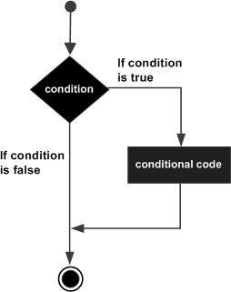
Selection
If (boolean_expression) {
// statement(s) will execute
// if the boolean expression is true
}

Slide 6
Ternary operator
if (y < 10 ) {
x = 30;
} else {
y = 40;
}
x = (y < 10) ? 30 : 40;

Slide 7
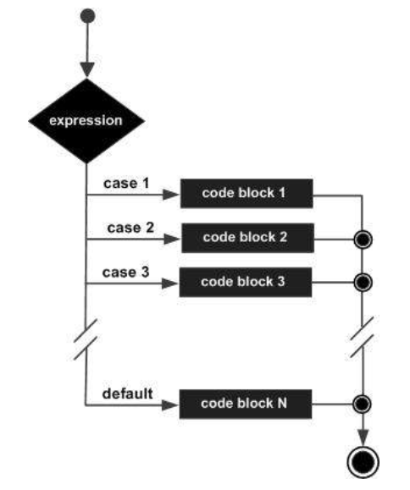
#include <iostream>
using namespace std;
int main () {
char grade = ‘D’;
switch(grade) {
case 'A’ :
cout << "Excellent!" << endl;
break;
case 'B’ :
case 'C’ :
cout << "Well done" << endl;
break;
case 'D’ :
cout << "You passed" << endl;
break;
case 'F’ :
cout << "Better try again" << endl;
break;
default :
cout << "Invalid grade" << endl;
}
cout << "Your grade is " << grade << endl;
return 0;
}

Slide 8
Today -- loops
Fruit Loops?

Slide 9
Types
For
While
Do … while
Nested

Slide 10
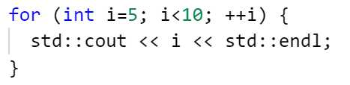
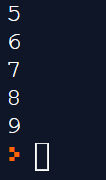

Slide 11
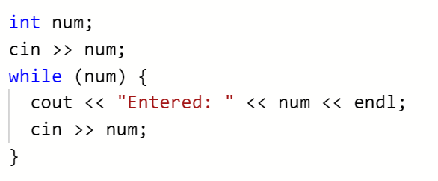
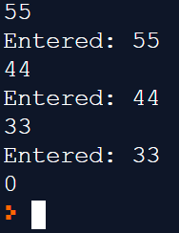

Slide 12
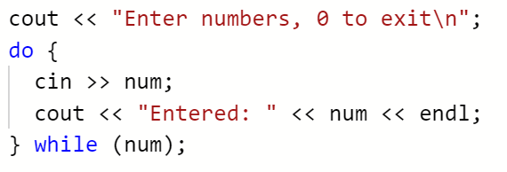
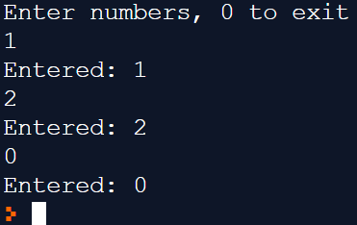

Slide 13
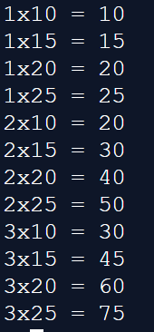
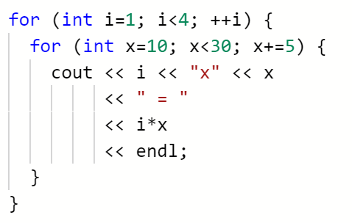
Nested loops

Slide 14
Control Statements
Break – terminates the loop (or switch)
Continue – skips the rest of the body to the point of condition testing
Goto – transfer control to labelled statement. Don’t use this.

Slide 15
Scope
Loops
Block
Variable scope

Slide 16
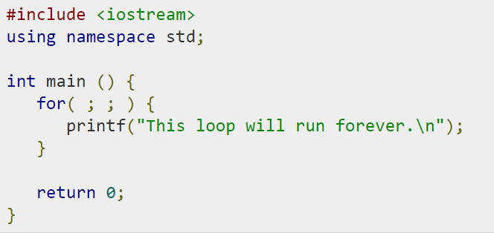

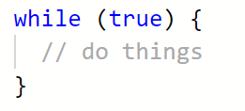
Infinite loop
Traditional way…
Don’t use this
Or this
Maybe use this

Slide 17
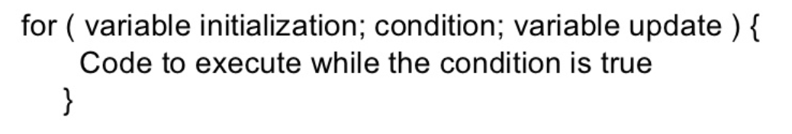
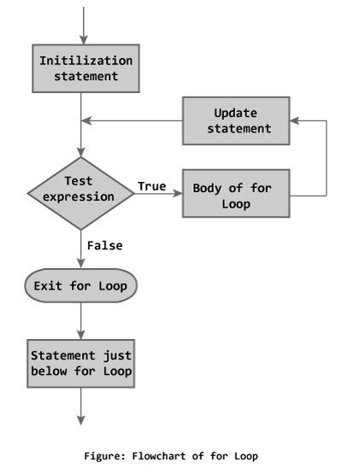
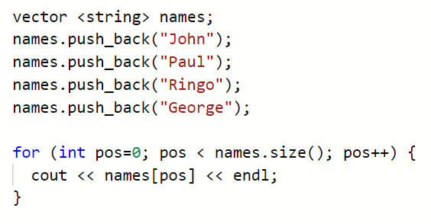
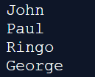
for

Slide 18
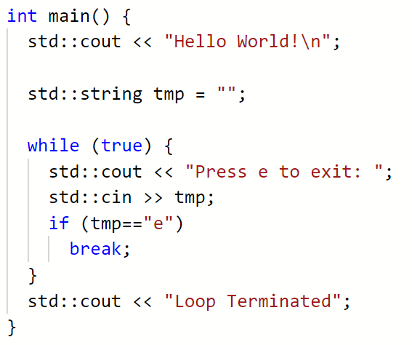
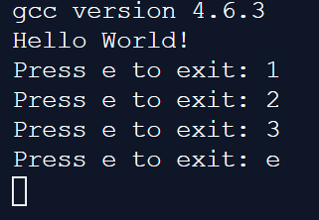

Slide 19
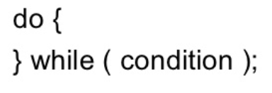
Do while
Note – this is the only loop that has a semi-colon terminating it.

Slide 20
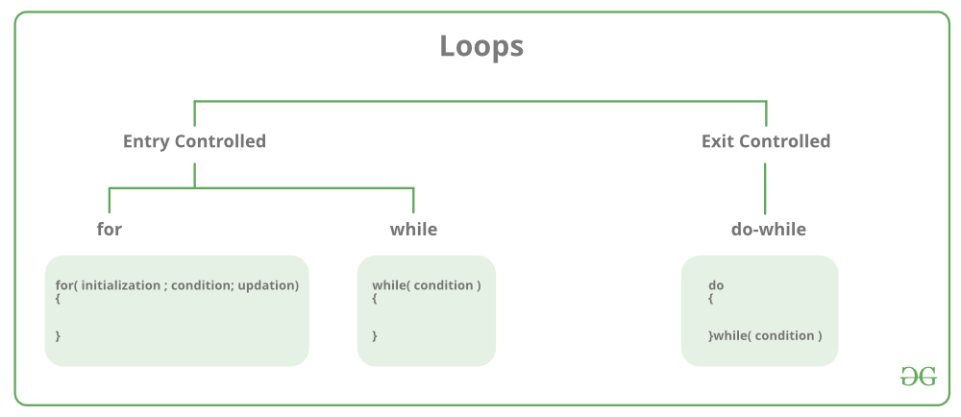

Slide 21
Documentation
The last bit of the assignment puzzle.

Slide 22
Assignment
You are required to produce the following:
IPO chart
Data dictionary
Flowchart
Evidence of successful compilation
Screenshots of the console input and output

Slide 23
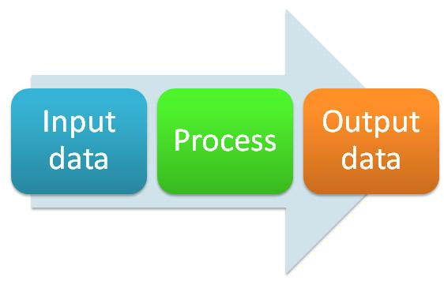
Input Process Output chart
What data items are input
What processing takes place on
the data
What information will be
the end result – the output

Slide 24
IPO chart
Input | Processing | Output
a | Enter first integer – a | Mean average
b | Enter second integer - b | Maximum number
c | Enter third integer - c
 | Calculate the mean
 | Calculate the maximum number

Slide 25
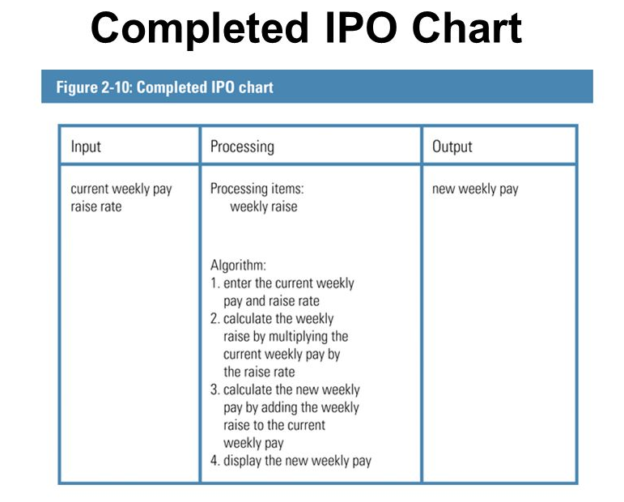

Slide 26
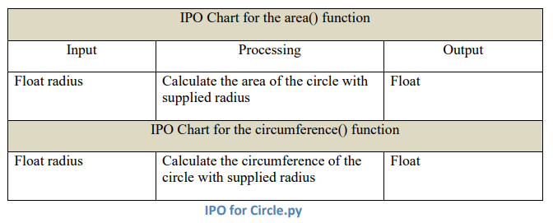

Slide 27
Flowcharts

Slide 28
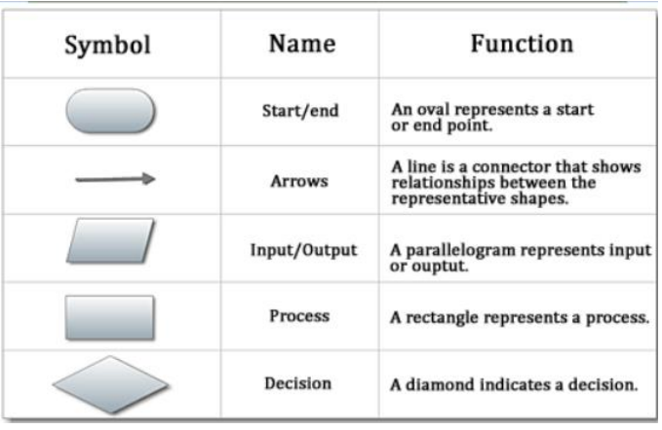

Slide 29
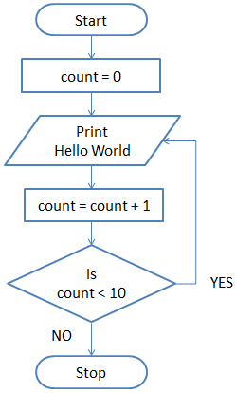
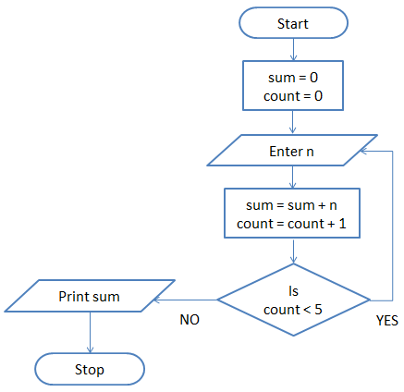

Slide 30
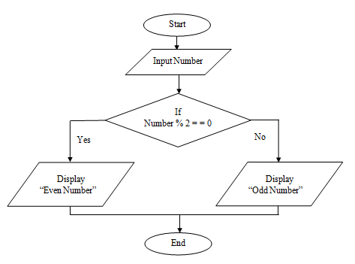

Slide 31
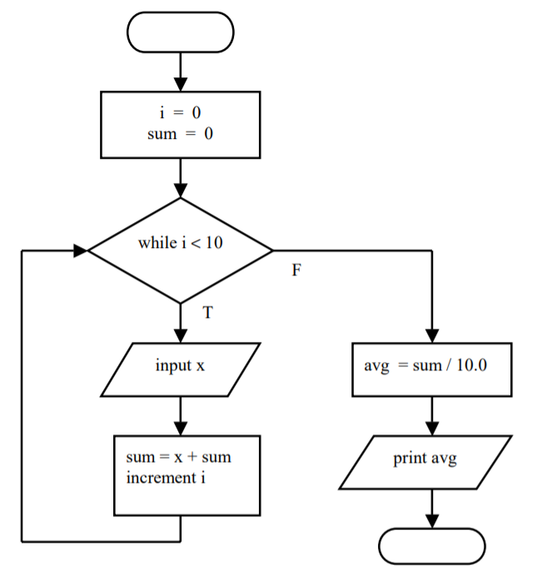

Slide 32
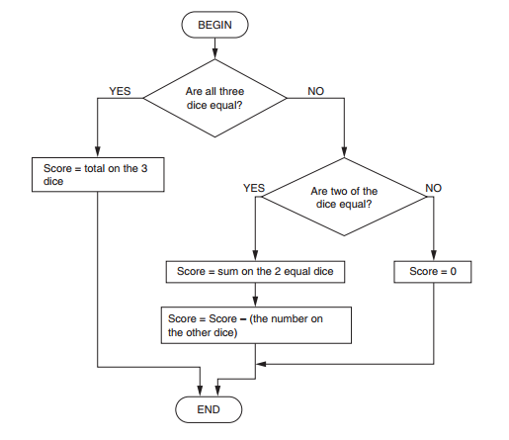

Slide 33
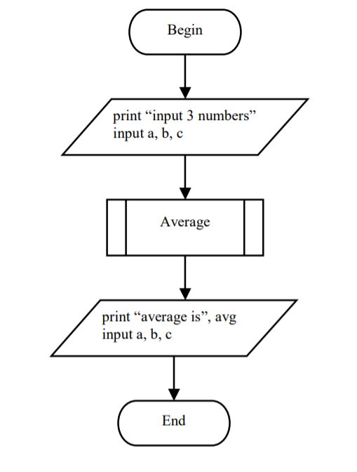
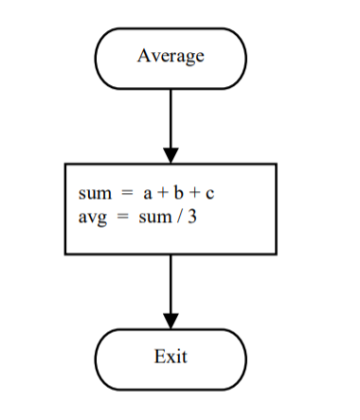

Slide 34
Tasks for this morning:
Assignment – due in on Monday the 4th Feb
Research flowcharts
Research flowchart software
Complete loops worksheet
Investigate the different types of loop in c++
Flowchart for different types of loop in c++
Work on assignment

